Slide 1
PRODUCT PROJECTS
And the process of creation
by
Helen Pastras

Slide 2
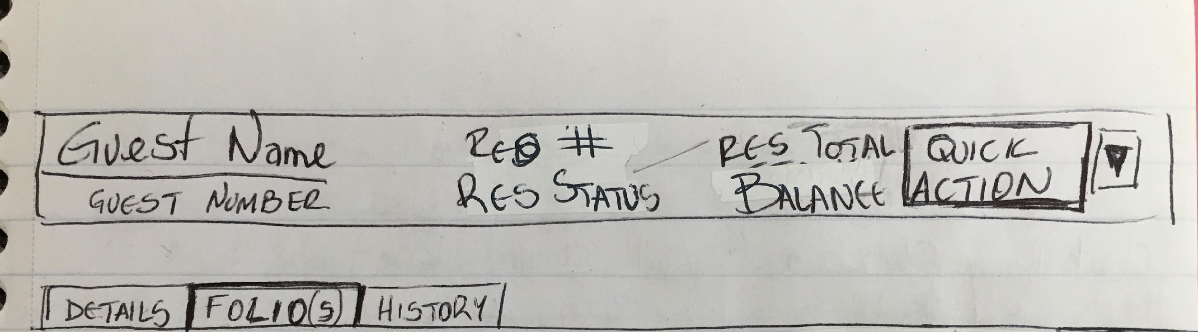
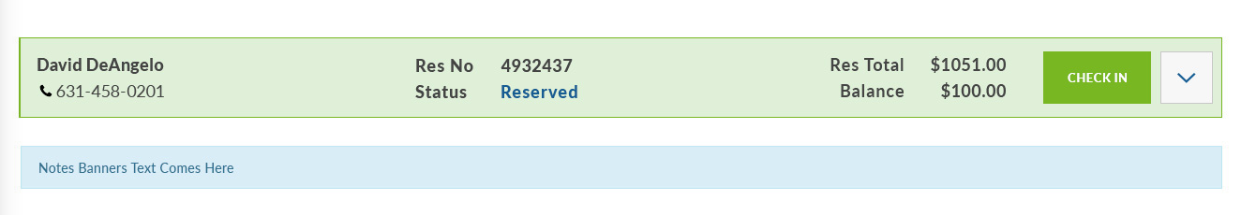
Reservation title bar.
Did not exist in original environment at all; it was created as an addition to new reservations.
Draft drawing
Clickable mock

Slide 3
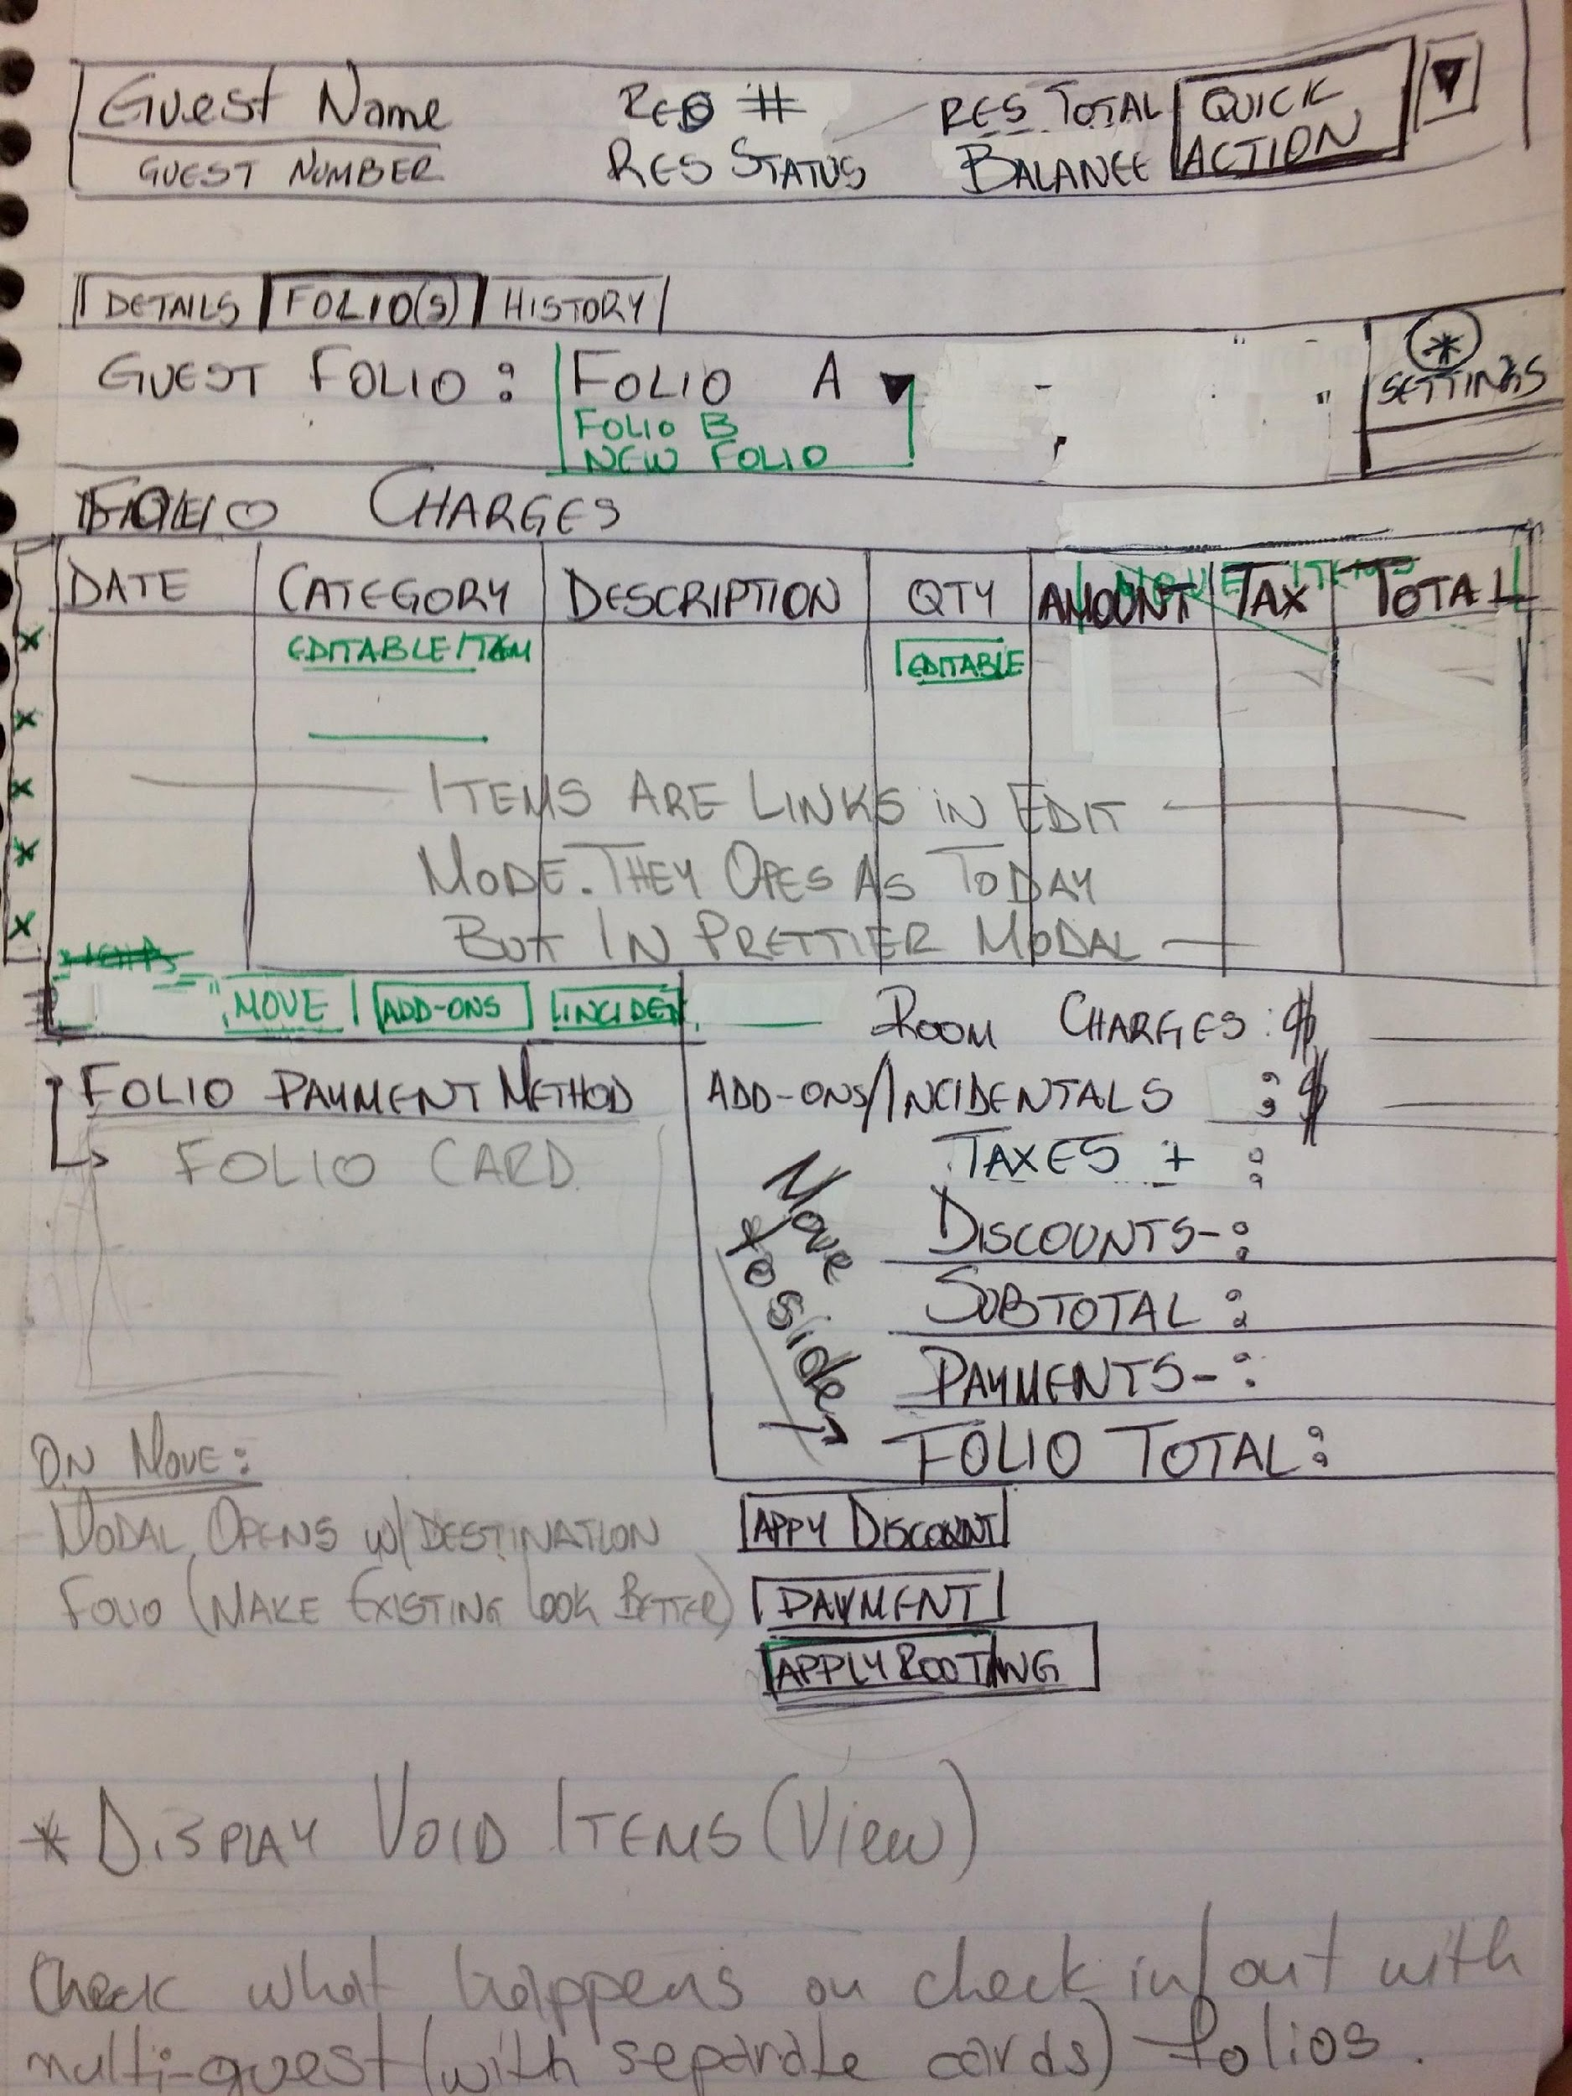
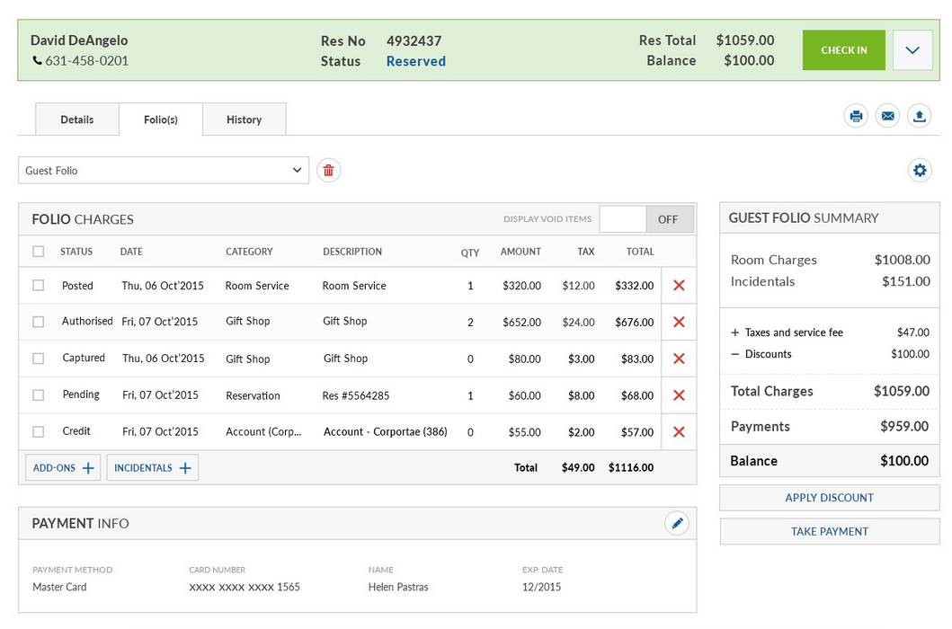
Reservation Folio View
A new view of the folio tab, for viewing different folios of a reservation, viewing and managing individual items and transactions.

Slide 4
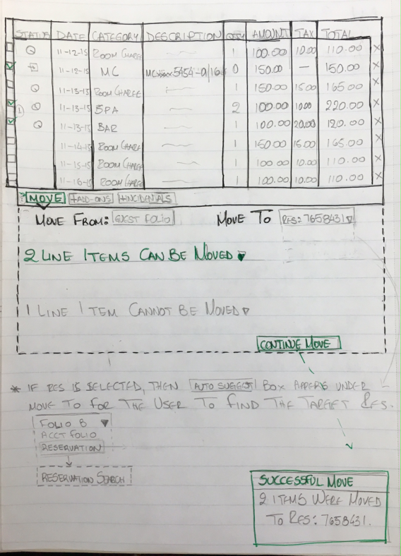
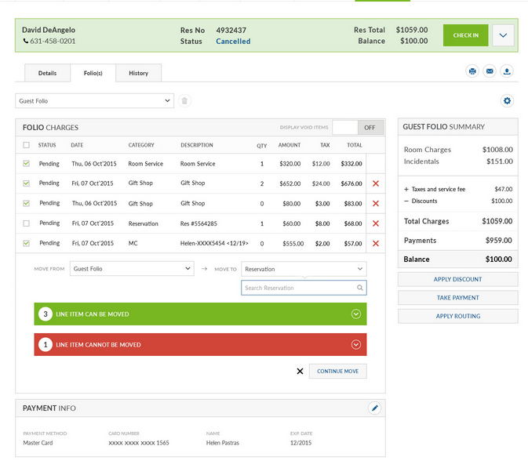
Folio line item moves
Additional functionality of the folio tab, showing the move of folio items to another folio of the same or another reservation.

Slide 5
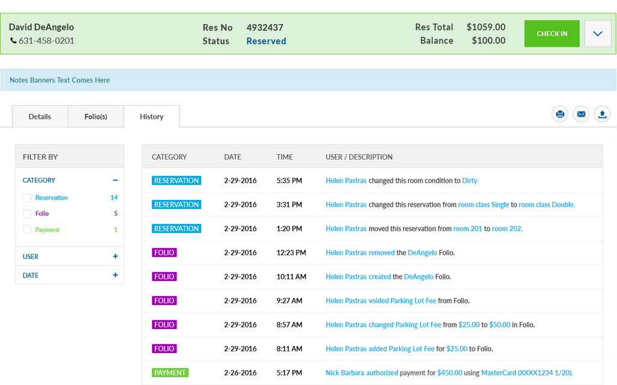
Logs for reservation activity
New feature of tracking the reservation activity, split in categories and further sorted by date and user.

Slide 6
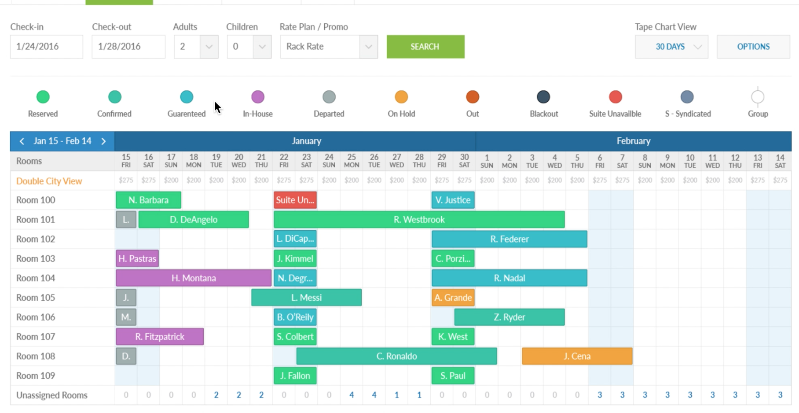
Tape Chart
Interactive view of availability and reservations, featuring availability search, view switches, and other display options.

Slide 7
TripAdvisor Project
Took project from initial analysis of specs and requirements from the partner, to writing up the stories and managing the process, sprint after sprint. On completion, followed up with Marketing for client and internal communication, sales and client services for training and then with clients for feedback.
Then started Version 7 of TripAdvisor, as it was released the week we went Live with the prior version; this project required work in our own product as it supports and requires fields that were previously not available in the system. Evaluated each, decided which ones we need to proceed with and which we can use information already available, added stories and worked on UI (with designer). On completion, followed up with the teams as in prior release, with added step extra training and client communication as we needed to manage the project of obtaining the information for the new fields form our clients.

Slide 8
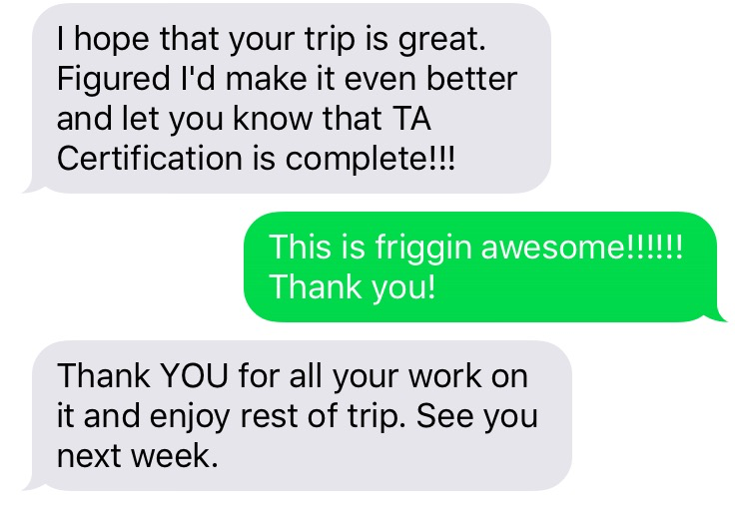
“Accolades”
Informal internal confirmation from Director of Product upon TripAdvisor Certification completion

Slide 9
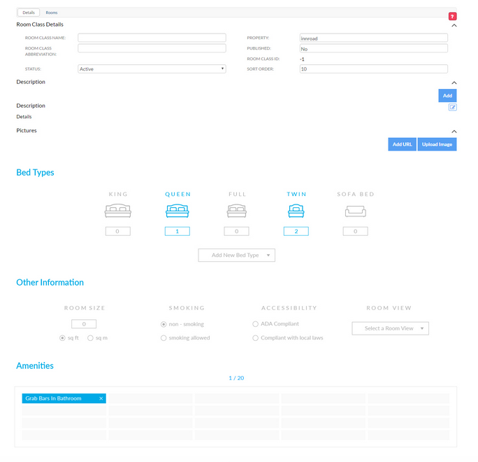
TripAdvisor Project - internal system additions.
To accommodate the new TripAdvisor integration, a new feature was built to enable further room details on the UI.

Slide 10
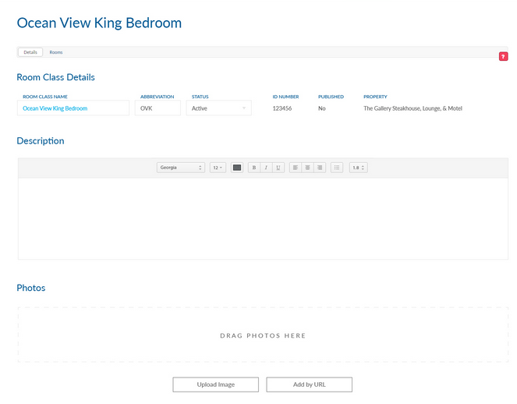
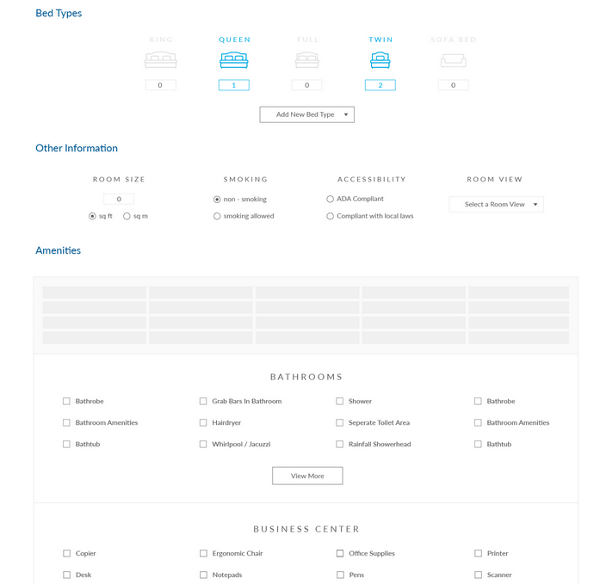
TripAdvisor Project - internal system additions.
One tab was dedicated to room display content and another to amenities, bed size and other categorizational details.

